Slide 1
Probates
Thomas Bernath

Slide 2
The materials appearing in this presentation are provided for informational use only, and are in no way intended to constitute legal advice or the opinions of this company. You should not act or rely upon any information appearing in this presentation without seeking the advice of an attorney. Moreover, because the law is constantly changing, the materials appearing on this website are not guaranteed to be correct, complete, or up-to-date.

Slide 6
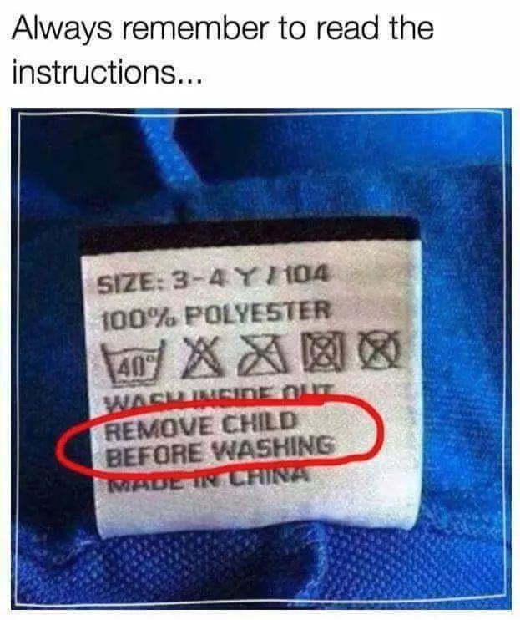

Slide 8
Two Ways to Avoid Probate
1. Stay alive, or
2. Do not own property at death. This can be accomplished by:
a. Joint tenancy.
Property automatically passes to the survivor, so the decedent does not own it and probate is unnecessary.
b. Community property with right of survivorship.
Again, property automatically passes to the survivor, so the decedent does not own it and probate is unnecessary.
c. Trusts or family partnerships.
The decedent does not own the property individually and a successor takes control of the property upon death.
Revocable Transfer Upon Death Deed

Slide 9
There are 2 key things to keep in mind when dealing with probates:
As soon as someone dies, his/her property is stuck in court.
The legally correct way to say this is: “Upon death, property vests in the heirs of the decedent, subject to administration by the Probate Court.”
We need to get the property out of the court. There are only two ways:
a. Court Order, OR
b. Procedure that takes the place of a Court Order.

Slide 10
Estate Planning
Do Nothing
Wills
Deed to kids or other family members
Hold “unrecorded” deed until death
Family Trusts
RTDD

Slide 11
Three types of Court Orders to get property out of court
Decree of Distribution
Order Determining Succession to Real Property
Order for a sale

Slide 12
Decree of Distribution - this is a probate court order that confirms title in the heirs.

Slide 13
Order Determining Succession to Real Property (PC §13150.)
If certain requirements are met, a person may seek an order distributing a decedent’s property without letters of administration being issued and without an entire probate proceeding.
40 days has passed since death.
Either no probate proceeding is pending in California, or the personal representative has filed a consent.
The gross value of the decedent's real and personal property in California does not exceed $100,000

Slide 14
Order for a sale - this is a court order for a sale to a third party during a probate.
a. Notice must be published in a newspaper (PC §10300).
b. The sale price must be at least 90% of the appraised value (PC §10309).
c. The Court holds a hearing to confirm the sale (PC §10308, 10310).
d. An order confirming the sale is issued (PC §10313).
e. The order must be recorded (PC §10314).
f. The personal representative executes a deed pursuant to the order (PC §10314).

Slide 15
Independent Administration of Estates Act (IAEA) (Probate Code §§10400-10592).
a. A probate is filed and the checkbox labeled “full authority” on the “Letters” issued by the Court must be checked.
NOTE: “full authority” does not mean full authority! It means property can be sold or encumbered without a court order ONLY IF certain notice procedures are followed and IF no objections are made. “Limited authority” means no authority!
b. The personal representative must give a “Notice of Proposed Action” at least 15 days in advance to heirs, devisees and anyone filing a request for notice. The “proposed action” can be a sale, encumbrance, lease, etc.
c. Notice does not need to be given to anyone who signs a consent or a “Waiver of Notice of Proposed Action”.
d. The personal representative may take the proposed action (e.g. sell the property) if no objections are filed before the date of the proposed action.
e. Usually we get a letter from an attorney stating that the procedures required by the IAEA were followed and that no objections were received.

Slide 16
Real property of small value ($50,000) (P.C. §13200).
a. Six months has passed since death.
b. The gross value of real property in the decedent’s estate located in California does not exceed $50,000. (Surprisingly, this actually does happen on occasion, usually with out-of-state residents whose only California real estate is a timeshare or vacant land in a remote location.).
c. A form entitled “Affidavit re Real Property of Small Value”, along with an appraisal must be filed with the Court Clerk, who signs the certificate on the form.
d. A certified copy of the form is recorded.

Slide 17
Surviving spouse’s right to dispose of community property (P.C. §13540).
a. 40 days has passed since death.
b. The property was community property.
c. The surviving spouse must record an affidavit stating that the statutory requirements have been satisfied.
d. The procedure does not apply if a third party records a notice claiming an interest in the property. (P.C. §13541.)

Slide 18
Deed of trust where the beneficiary is deceased. ($150,000) (P.C. §13106.5.)
a. 40 days has passed since death.
b. The gross value of the decedent's property in California does not exceed $150,000.
c. No probate has been filed in California.
d. The successor must record an affidavit stating that the statutory requirements have been satisfied.
Appeals.

Slide 19
REVOCABLE TRANSFER ON DEATH DEED?: A Transfer on Death Deed is a simple, inexpensive way to transfer real estate to someone else upon your death. It does not involve going through probate court, which can be a lengthy and costly process. It works similarly to a life insurance policy or a payable on death account at a bank because the asset passes to your named beneficiary upon your death outside the probate system.

Slide 20
In order for the deed to be valid, the RTDD must be recorded with 60 days of the ate it was signed and notarized and prior to the death of the transferor.
If the Beneficiary predeceases the Grantor, the RTDD is void
The use of the RTDD is limited to “residential real property”

Slide 21
The beneficiary is liable for debts of the transferor for 3 years. (Probate Code §§ 5672, 5674, and 5676).
The beneficiary is subject to restitution to the transferor’s estate of the property the beneficiary received pursuant to the revocable transfer on death deed if the beneficiary still has the property. [Probate Code § 5676(a)(1)].

Slide 22
Property transferred by a revocable transfer on death deed is subject to the claims of the State Department of Health Care Services to extent authorized by law. Probate Code §5654(b)
The personal representative can only challenge the RTDD for a period of 120 days. Any purchaser during that period would arguably not be a bona fide purchaser. [Probate Code § 5694(a)],

Slide 23
However, nothing in the law limits the applicability of the principles of fraud, undue influence, duress, mistake, or other invalidating cause to a transfer of property by a revocable transfer on death deed. [Probate Code § 5696(a)]. I see no limitation on time for an action to be brought by the personal representative on this basis.

Slide 24
A.B. 1739, effective July 9,2018
– Amended Probate Code § 5626, to include specifically that the “Common Questions” do not need to be recorded.
Current amendments being considered by the California Law Revision Commission
– Changing the definition of “beneficiary” to include trusts and entities.
– Allowing for the use of a POA on behalf of the owner to create a RTODD.

Slide 25
Appeals.
An appeal stays the operation and effect of a probate court judgment or order (Probate Code Section 1310(a)). As with other judgments, the time for appeal is 60 days after a “notice of entry” of the judgment or 180 days from entry of the judgment if no notice is given. Underwriters may waive the requirement of waiting until the judgment becomes final if the judgment was not contested.

Slide 26
Ancillary proceedings.
A court order from the out of state court distributing California real property is not valid. Only a California court has jurisdiction to deal with California real estate, so you need to file an “Ancillary Proceeding” in a California court (Probate Code Section 12510).

Slide 27
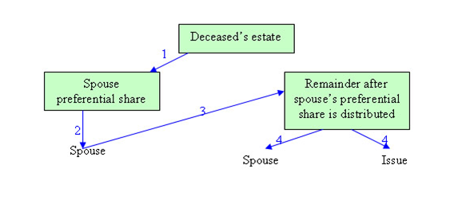

Slide 28
Each state has its own laws (laws of intestate succession) governing the distribution of a decedent's property should the person fail to make a will. The law of the state in which the decedent lived at the time of his death typically governs (but even this isn't always the case, especially with out-of-state real property). These laws can change.
The following chart summarizes the California laws of intestacy (found in Probate Code Sections 6400 and following).
If the Decedent had a Surviving Spouse, then:
Ownership of Property: Disposition:
Community and "Quasi-community" Property: All of to spouse
Decedent's Separate Property: All to spouse if there is no surviving children, parent, brother, sister, or children of deceased brother or sister
One-half to spouse if: Deceased left one child or issue of one deceased child; or
Decedent leaves no child but does leave a parent or parents or their children (decedent's brothers or sisters) or their children
One-third to spouse if: Decedent leaves more than one child; or
Decedent leaves one child and the issue of one or more deceased children; or
Decedent leaves issue of two or more deceased children.

Slide 29
Property not passing to the Decedent's Surviving Spouse (if any) goes to....
Heirs: Disposition (in order of preference):
If children, then: All to issue of decedent equally if of same degree of kinship
If no children, then: To decedent's parents equally;
To the issue of parents or either of them, equally if all of the same degree of kinship;
To decedent's grandparents equally, or, if deceased, to their issue equally if all the same degree of kinship;
To the issue of a predeceased spouse, equally if all the same degree of kinship;
To the next of kin in equal degree, but where there are two or more collateral kindred in equal degree who claim through different ancestors, those who claim through the nearest ancestor are preferred to those claiming through an ancestor more remote;
To the parents of a predeceased spouse equally, or if none, to the issue of such parents equally if all the same degree of kinship.

